Slide 1
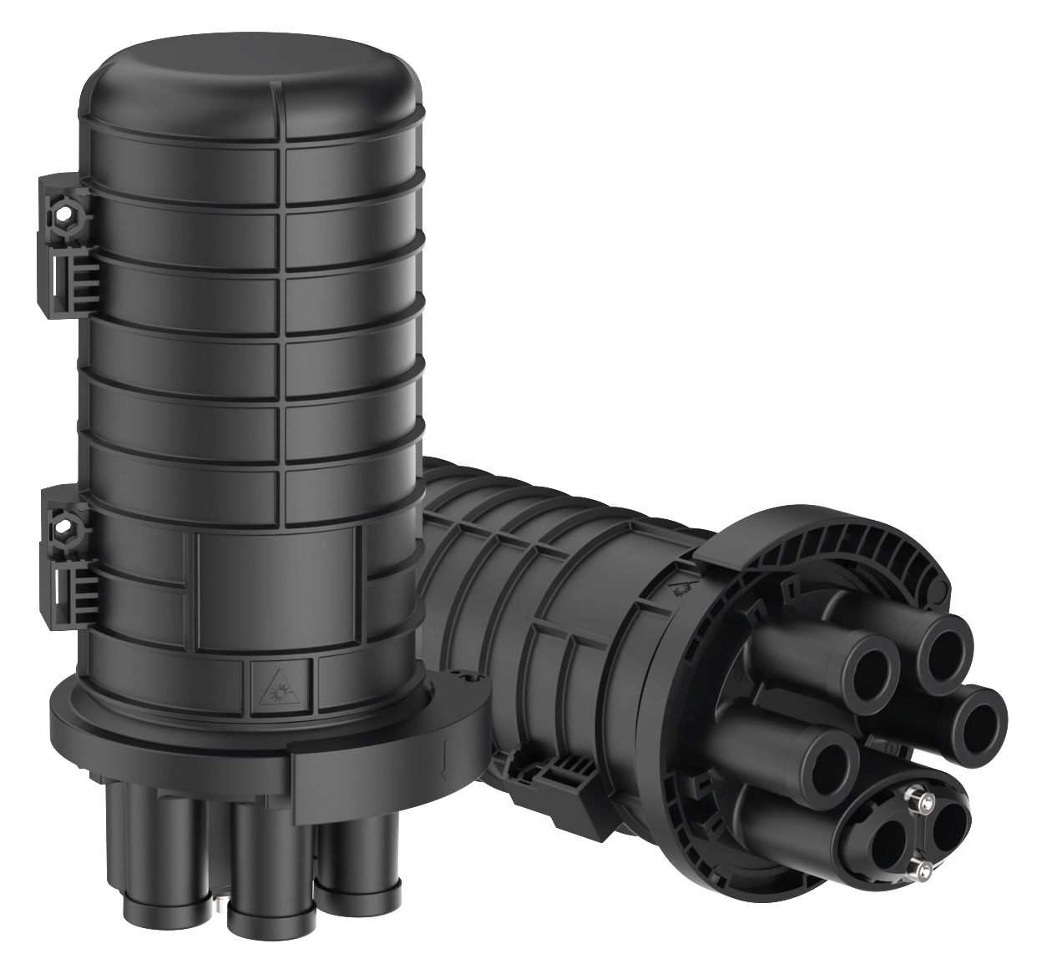
LitJTP-180J-C104-V104 Dome-Base Closure
Mechanical sealing, 48F splicing
LitJTP-180J series are dome-base closures with mechanical sealing, which are designed for all cable application environments such as duct, aerial, and man-hole. LitJTP supports numerous functions as mid-span, branch and direct splice. The closure is accommodated with flexible splice trays and various accessories are available for many scenarios. Rigorous tests are performed to approve the best quality for network reliability.
Features
Dome-base design structure with mechanical sealing
High-strength modified polypropylene material
Mid-span operation without cutting the cable
Flexible grommets for universal standardized cables
Ideal fiber management design
Application
Outdoor application
Wall, pole, wire mounting scenarios

Slide 2
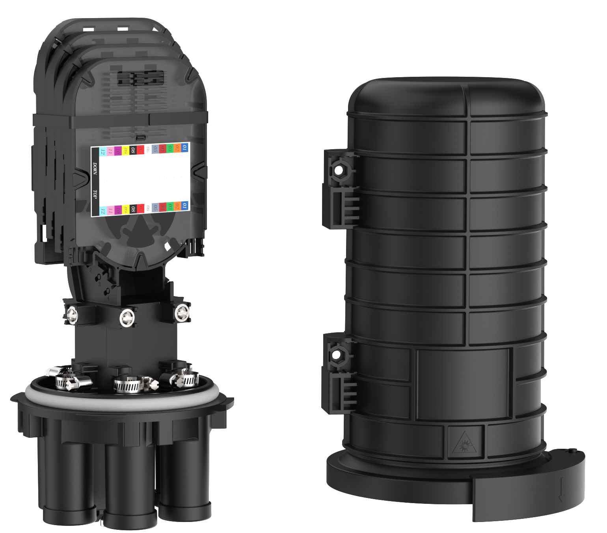
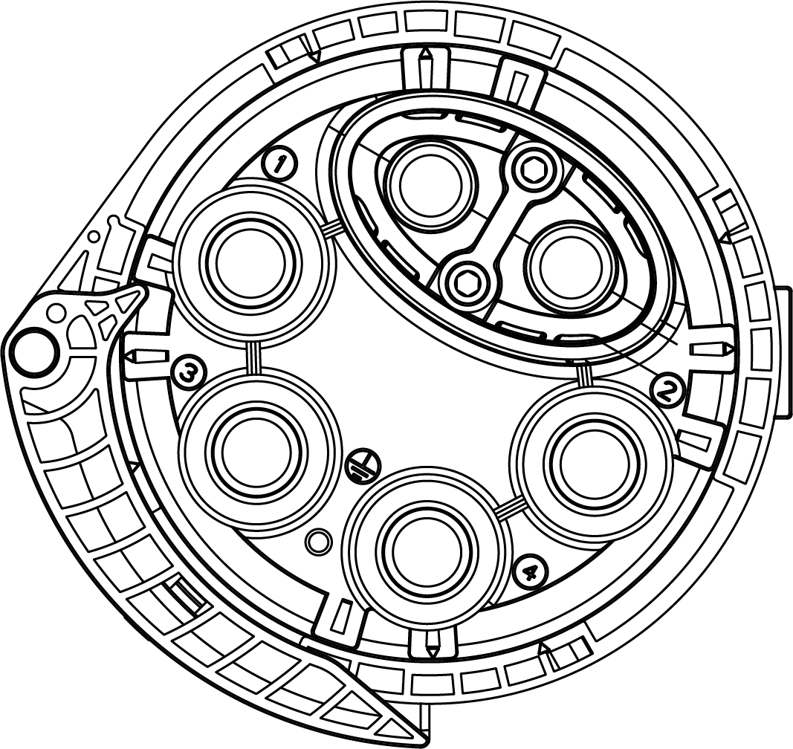
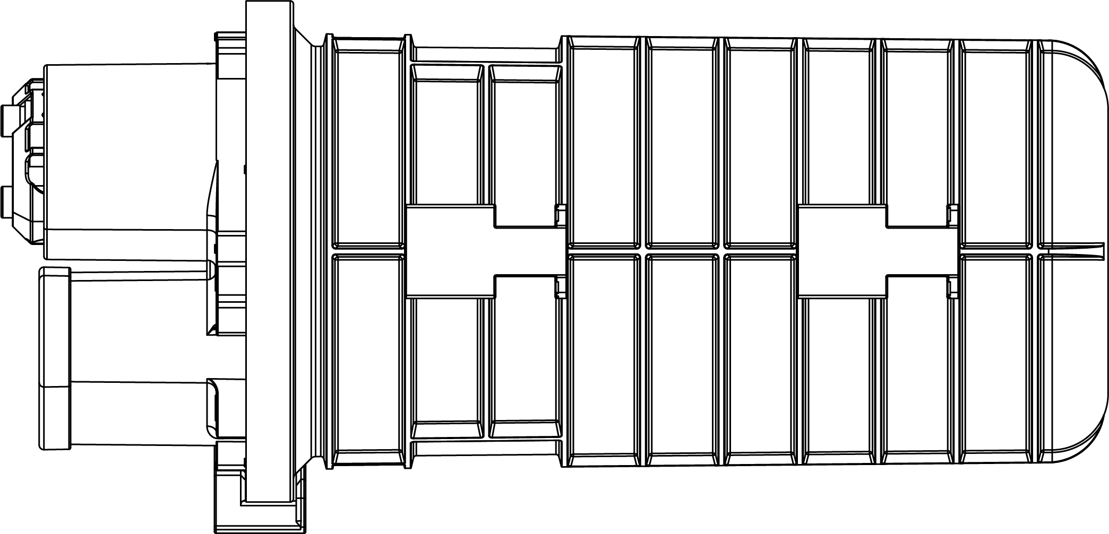
Specifications
Item | Specification
Dimension | Φ180mm × 353mm (±5mm)
Oval hole diameter | Φ10-18mm
Round hole diameter | Φ8-14mm
Splice tray capacity (single fiber) | 12F
Number of splice tray | 4 pcs (No. V1 splice tray)
Splicing capacity (single fiber) | 48F
Sealing mode | Mechanical sealing
Color | Black
Product Details
Splice tray
Dome shell
1 oval hole
Fixing platform
Sealing ring
Base
Latch
4 round holes
L
D
D2
D1
D = 180mm; D1 = 130mm; D2 = 160mm; L = 353mm

Slide 3
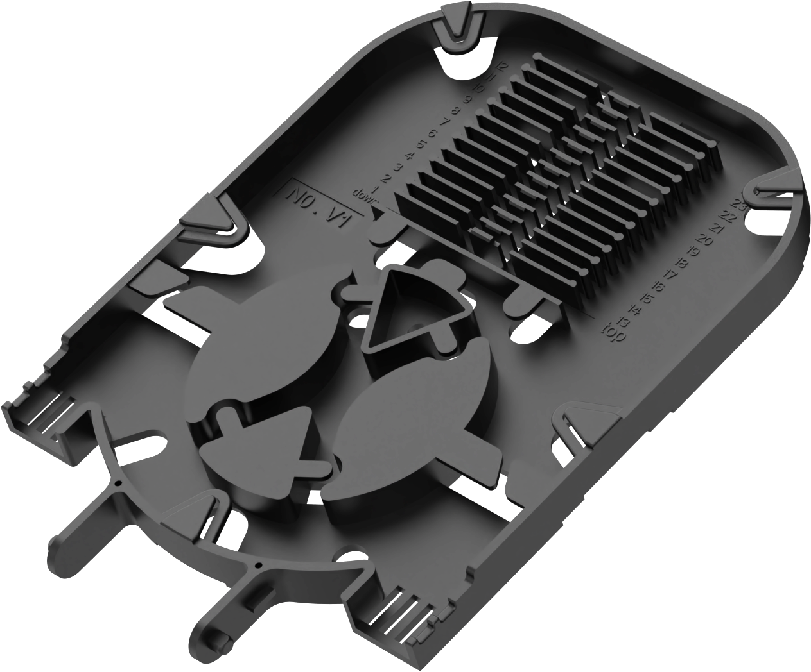
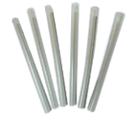
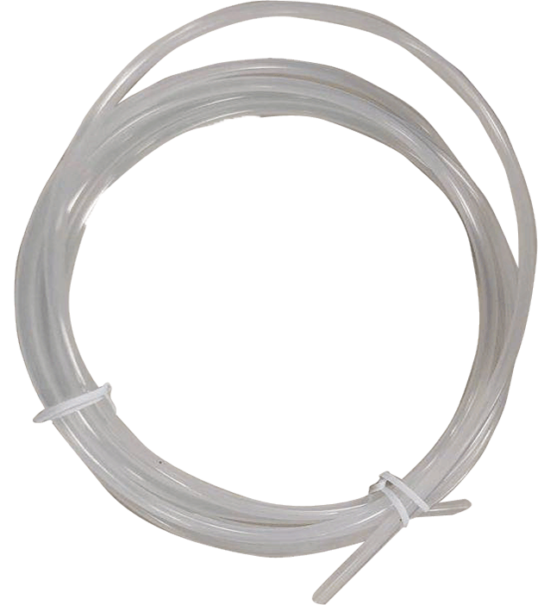
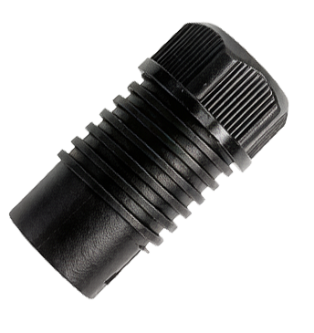
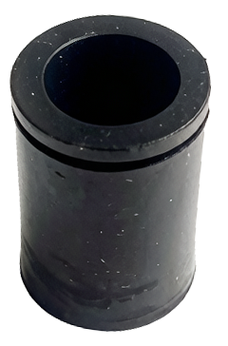
Splice Tray
Item | NO. V1 splice tray
Function | Fiber splice and storage
Dimension | 158mm × 110mm × 10mm
Splice capacity (single fiber) | 12F
Product photo
Accessory List
Standard Accessories
No. | Name | Picture | Quantity
1 | Fiber splice protective sleeve |  | 48 pcs
2 | Nylon cable tie |  | 16 pcs
3 | Bare fiber protective sleeve |  | 2m
4 | Branch clamp nut |  | 2 pcs
5 | Φ10-14mm sealing plug (for branch cable) |  | 2 pcs

Slide 4


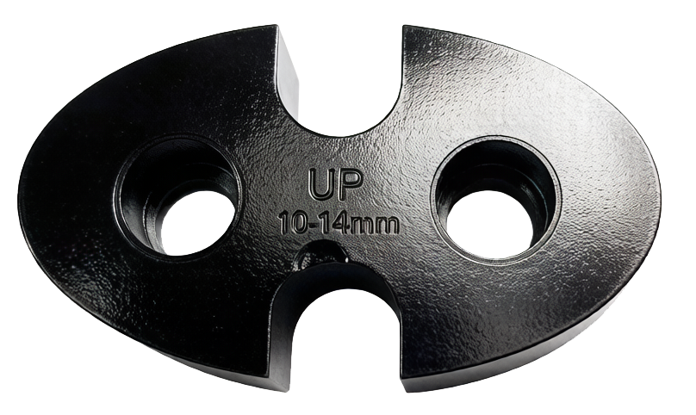
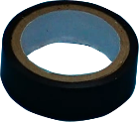
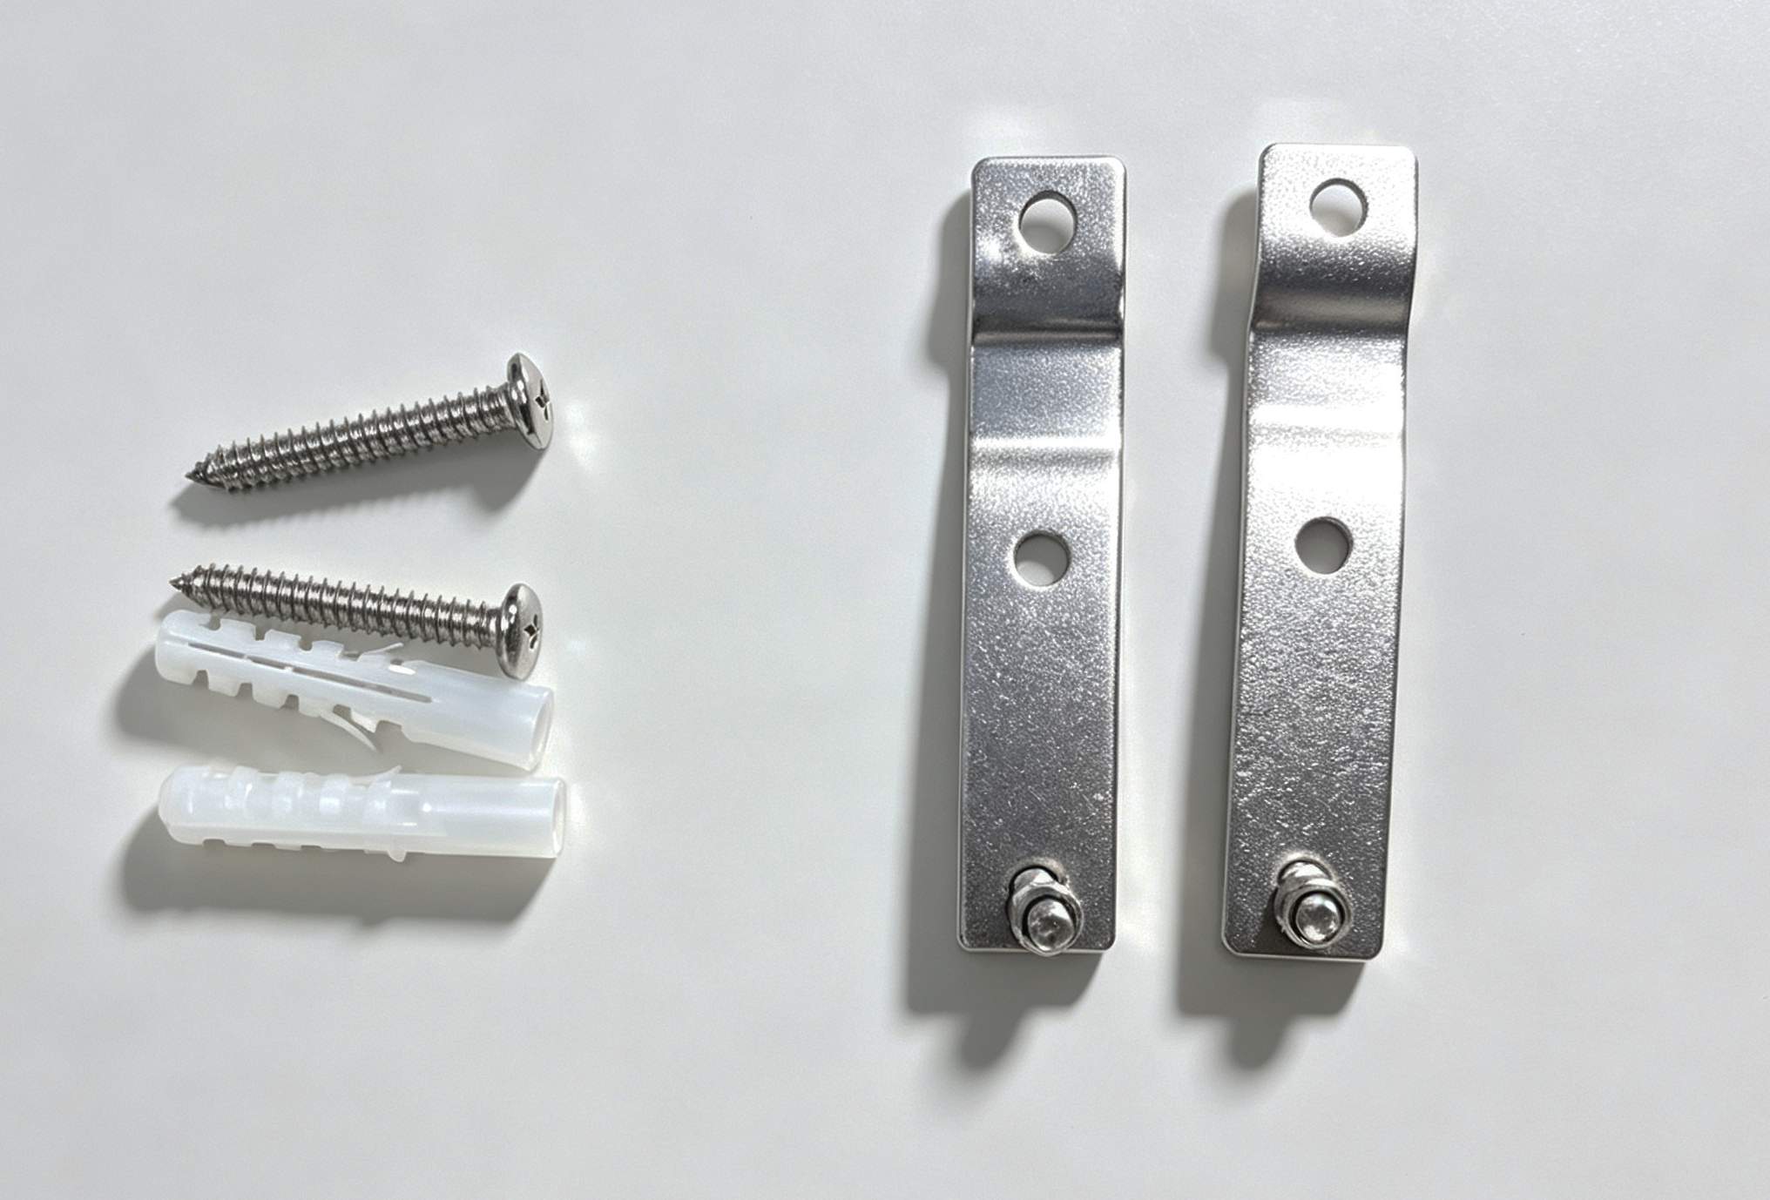
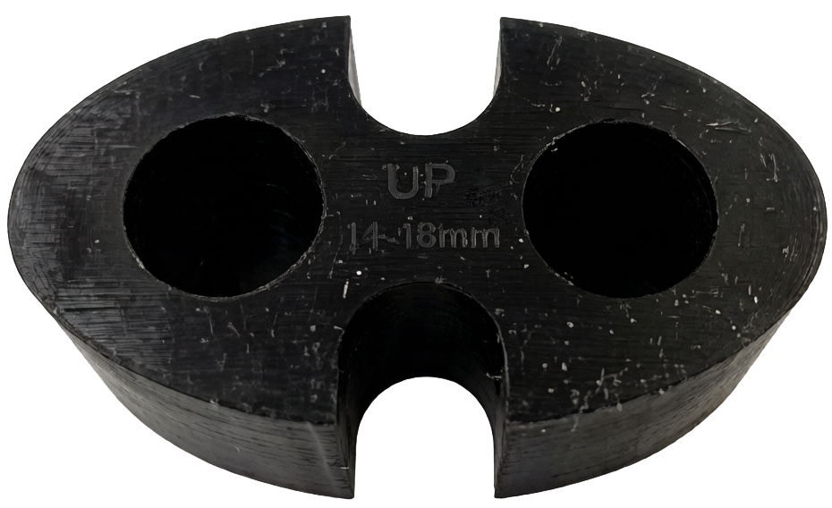
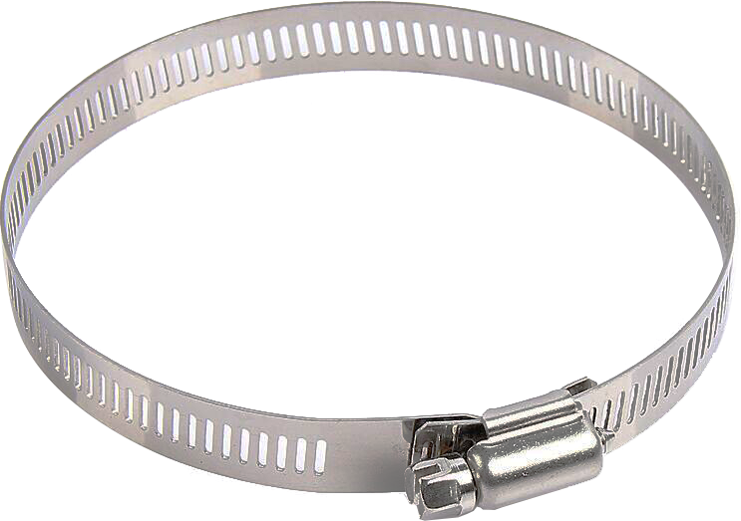
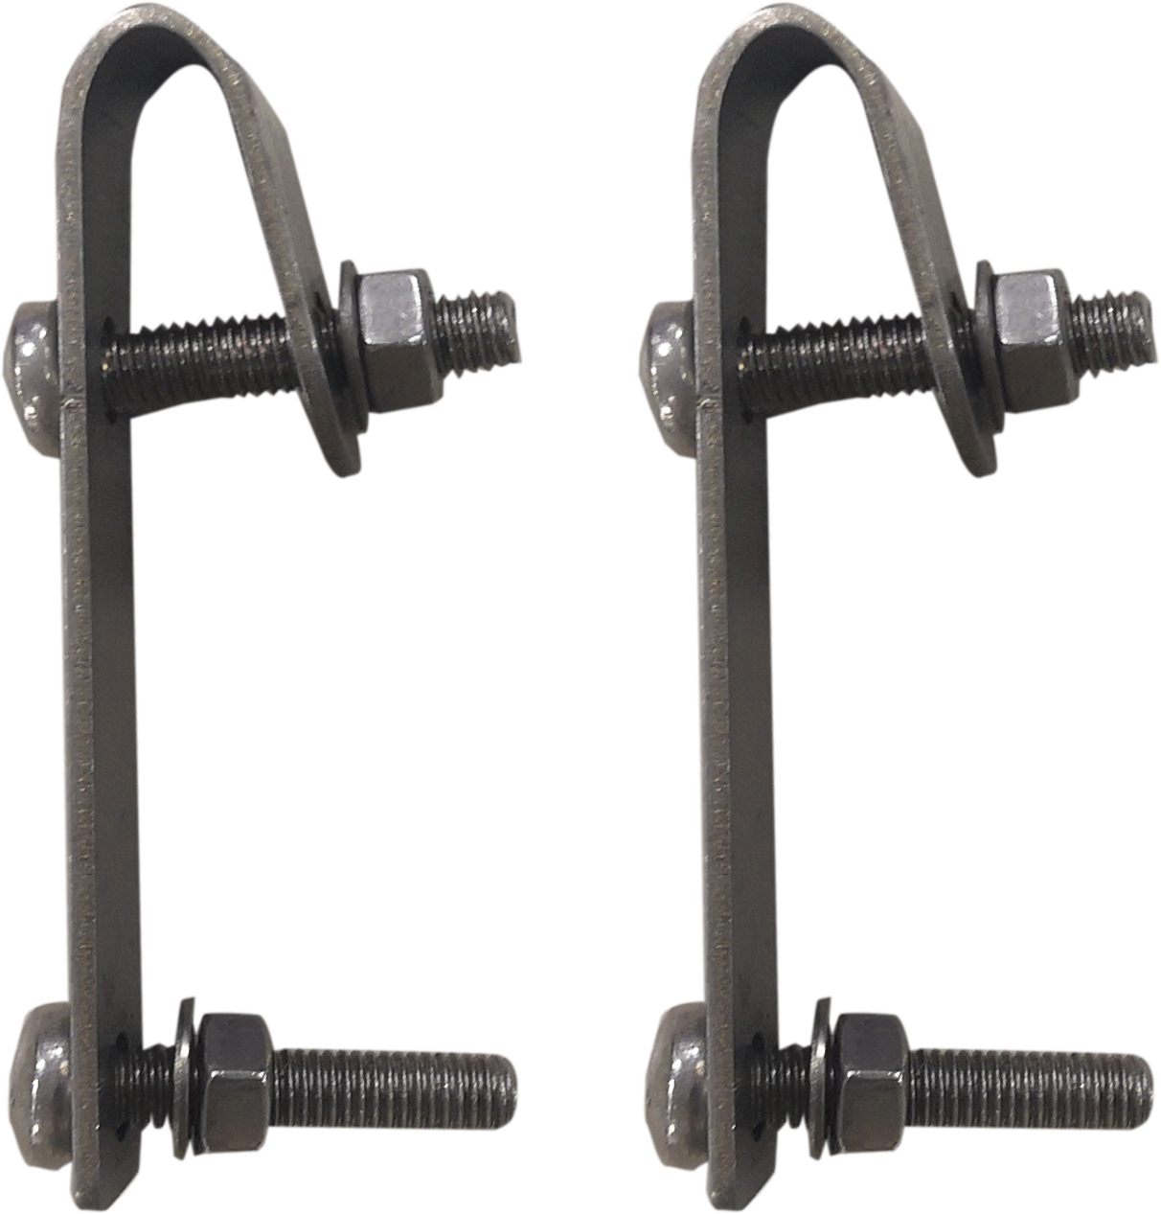
6 | Wrench for branch clamp nut |  | 1 pc
7 | Allen key |  | 1 pc
8 | Φ10-14mm double-hole sealing plug (for mid-span cable) |  | 1 pc
9 | Insulation tape |  | 2m
10 | Wall mounting kit |  | 1 set (2 brackets, 2 M5 screws, 2 M5 hex nuts, 2 self-tapping screws, 2 plastic expansion sleeves)
Optional Accessories
No. | Name | Picture | Quantity
1 | Φ14-18mm double-hole sealing plug (for mid-span cable) |  | 1 pc
2 | Branch clamp nut |  | 2 pcs
3 | Φ10-14mm sealing plug (for branch cable) |  | 2 pcs
4 | Pole mounting kit |  | 1 set (2 pole hoops)
5 | Wire mounting kit |  | 1 set (2 hooks)

